Slide 1
A Guide to SQL, Ninth Edition
Chapter Four
Single-Table Queries

Slide 2
Objectives
Retrieve data from a database using SQL commands
Use simple and compound conditions in queries
Use the BETWEEN, LIKE, and IN operators in queries
Use computed columns in queries
©2016 Cengage Learning. All Rights Reserved. May not be copied, scanned, or duplicated, in whole or in part, except for use as permitted in a license distributed with a certain product or service or otherwise on a password-protected website for classroom use.

Slide 3
Objectives (continued)
Sort data using the ORDER BY clause
Sort data using multiple keys and in ascending and descending order
Use aggregate functions in a query
Use subqueries
Group data using the GROUP BY clause
©2016 Cengage Learning. All Rights Reserved. May not be copied, scanned, or duplicated, in whole or in part, except for use as permitted in a license distributed with a certain product or service or otherwise on a password-protected website for classroom use.

Slide 4
Objectives (continued)
Select individual groups of data using the HAVING clause
Retrieve columns with null values
©2016 Cengage Learning. All Rights Reserved. May not be copied, scanned, or duplicated, in whole or in part, except for use as permitted in a license distributed with a certain product or service or otherwise on a password-protected website for classroom use.

Slide 5
Constructing Simple Queries
What is a query ?
  Question represented in a way that the DBMS can understand
How do you implement in SQL?
  Use SELECT command
Are there any special formatting rules?
  No
©2016 Cengage Learning. All Rights Reserved. May not be copied, scanned, or duplicated, in whole or in part, except for use as permitted in a license distributed with a certain product or service or otherwise on a password-protected website for classroom use.

Slide 6
Constructing Simple Queries (continued)
SELECT-FROM-WHERE statement
  SELECT columns to include in result
  FROM table containing columns
  WHERE any conditions to apply to the data
WHERE clause is optional
©2016 Cengage Learning. All Rights Reserved. May not be copied, scanned, or duplicated, in whole or in part, except for use as permitted in a license distributed with a certain product or service or otherwise on a password-protected website for classroom use.

Slide 7
Retrieving Certain Columns and Rows
Use SELECT command to retrieve specified columns and all rows
  List the number, name, and balance of all customers
No WHERE clause needed, because all customers are requested
©2016 Cengage Learning. All Rights Reserved. May not be copied, scanned, or duplicated, in whole or in part, except for use as permitted in a license distributed with a certain product or service or otherwise on a password-protected website for classroom use.

Slide 8
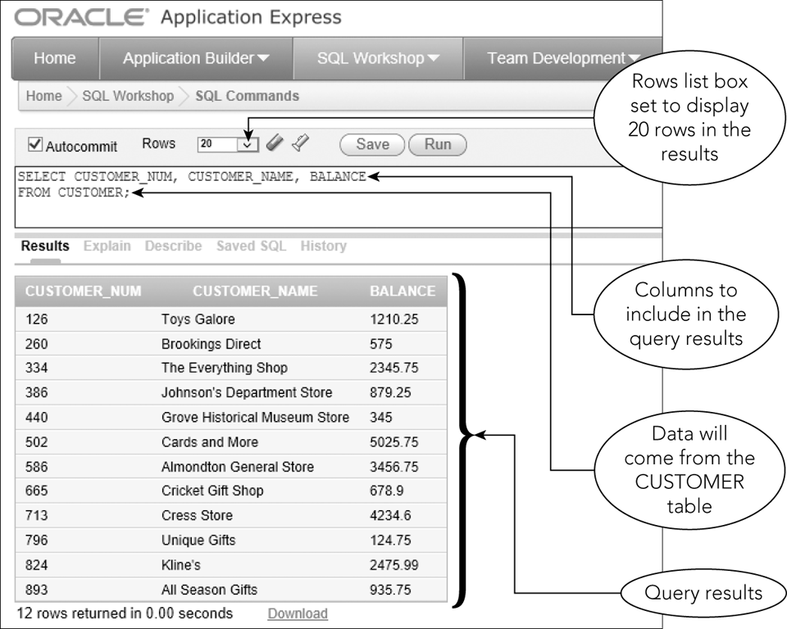
Retrieving Certain Columns and Rows (continued)
Figure 4-1: SELECT command to select certain columns from the CUSTOMER table
©2016 Cengage Learning. All Rights Reserved. May not be copied, scanned, or duplicated, in whole or in part, except for use as permitted in a license distributed with a certain product or service or otherwise on a password-protected website for classroom use.

Slide 9
Retrieving All Columns and Rows
Use an asterisk (*) to indicate all columns in the SELECT clause
Will list all columns in the order used when table was created
List specific columns in SELECT clause to present columns in a different order
©2016 Cengage Learning. All Rights Reserved. May not be copied, scanned, or duplicated, in whole or in part, except for use as permitted in a license distributed with a certain product or service or otherwise on a password-protected website for classroom use.

Slide 10
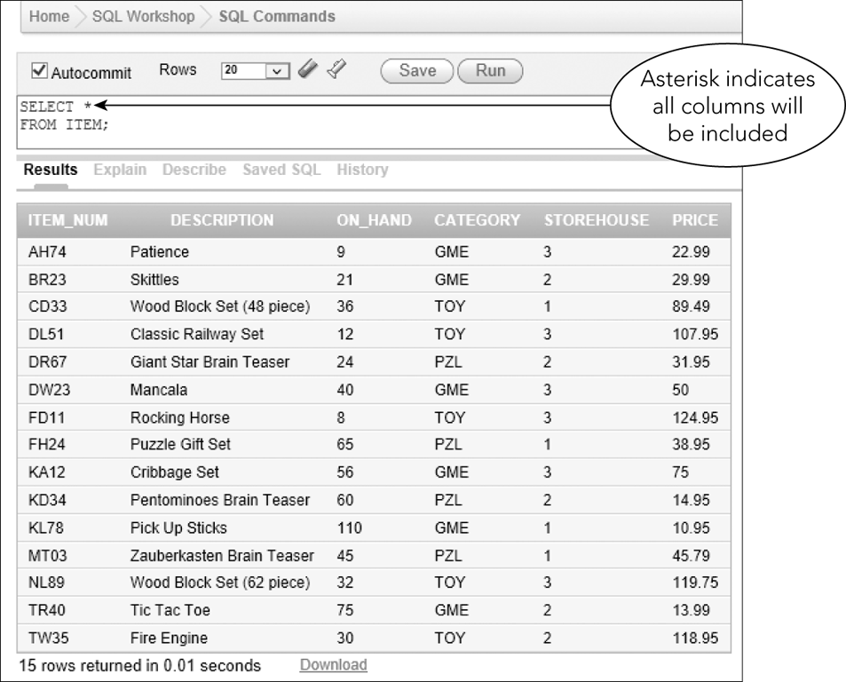
Retrieving All Columns and Rows (continued)
Figure 4-2: SELECT command to select all columns from the ITEM table
©2016 Cengage Learning. All Rights Reserved. May not be copied, scanned, or duplicated, in whole or in part, except for use as permitted in a license distributed with a certain product or service or otherwise on a password-protected website for classroom use.

Slide 11
Using a WHERE Clause
WHERE clause
  Used to retrieve rows that satisfy some condition
  What is the name of customer number 126?
Simple Condition
  Column name, comparison operator followed by either a column name or a value
©2016 Cengage Learning. All Rights Reserved. May not be copied, scanned, or duplicated, in whole or in part, except for use as permitted in a license distributed with a certain product or service or otherwise on a password-protected website for classroom use.

Slide 12
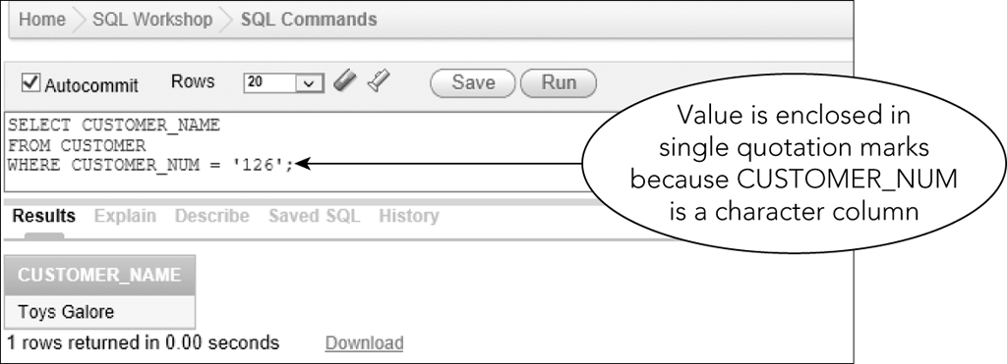
Using a WHERE Clause (continued)
Figure 4-3: SELECT command to find the name of customer number 126
©2016 Cengage Learning. All Rights Reserved. May not be copied, scanned, or duplicated, in whole or in part, except for use as permitted in a license distributed with a certain product or service or otherwise on a password-protected website for classroom use.

Slide 13
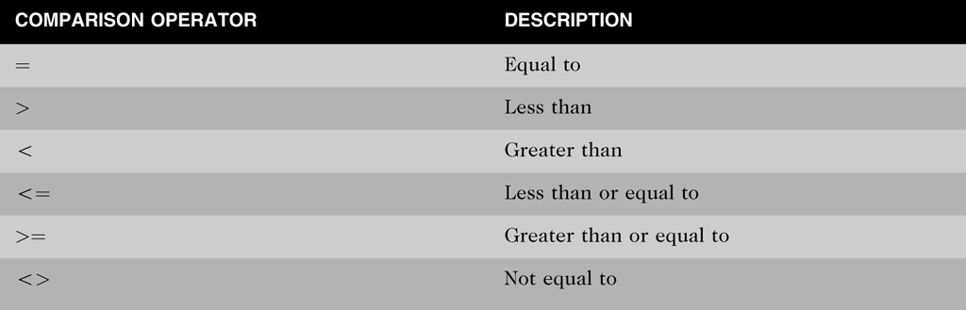
Using a WHERE Clause (continued)
Figure 4-4: Comparison operators used in SQL commands
©2016 Cengage Learning. All Rights Reserved. May not be copied, scanned, or duplicated, in whole or in part, except for use as permitted in a license distributed with a certain product or service or otherwise on a password-protected website for classroom use.

Slide 14
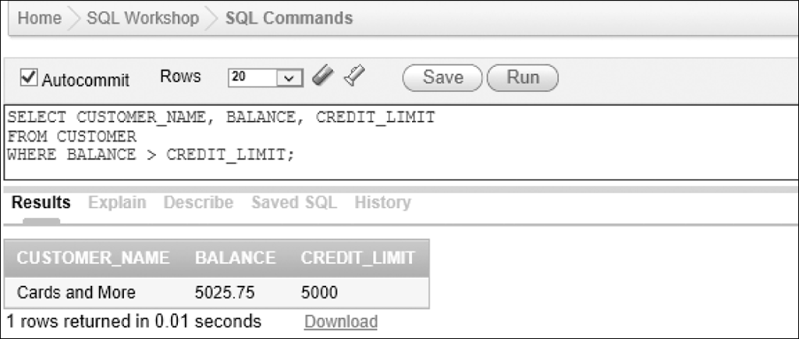
Using a WHERE Clause (continued)
Simple conditions can compare columns
Figure 4-6: SELECT command to find all customers with balances that exceed their credit limits
©2016 Cengage Learning. All Rights Reserved. May not be copied, scanned, or duplicated, in whole or in part, except for use as permitted in a license distributed with a certain product or service or otherwise on a password-protected website for classroom use.

Slide 15
Using Compound Conditions
Compound conditions
  Connect two or more simple conditions with AND, OR, and NOT operators
AND operator: all simple conditions are true
OR operator: any simple condition is true
NOT operator: reverses the truth of the original condition
©2016 Cengage Learning. All Rights Reserved. May not be copied, scanned, or duplicated, in whole or in part, except for use as permitted in a license distributed with a certain product or service or otherwise on a password-protected website for classroom use.

Slide 16
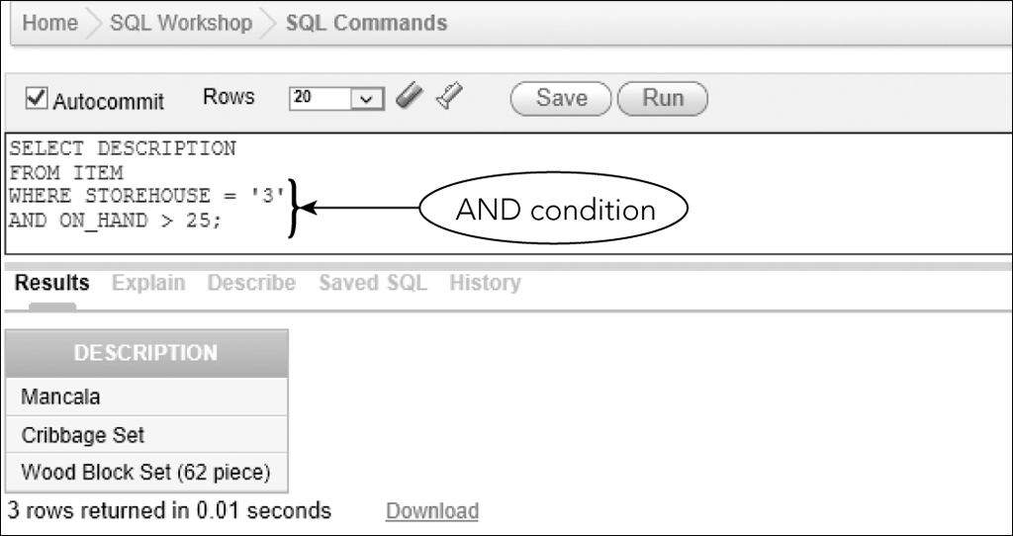
Using Compound Conditions (continued)
Figure 4-7: SELECT command with an AND condition on separate lines
©2016 Cengage Learning. All Rights Reserved. May not be copied, scanned, or duplicated, in whole or in part, except for use as permitted in a license distributed with a certain product or service or otherwise on a password-protected website for classroom use.

Slide 17
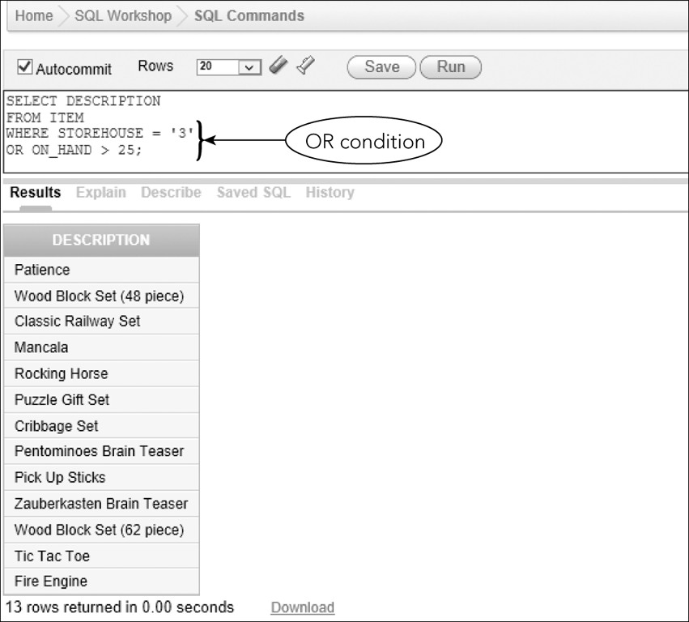
Using Compound Conditions (continued)
Figure 4-9: SELECT command with an OR condition
©2016 Cengage Learning. All Rights Reserved. May not be copied, scanned, or duplicated, in whole or in part, except for use as permitted in a license distributed with a certain product or service or otherwise on a password-protected website for classroom use.

Slide 18
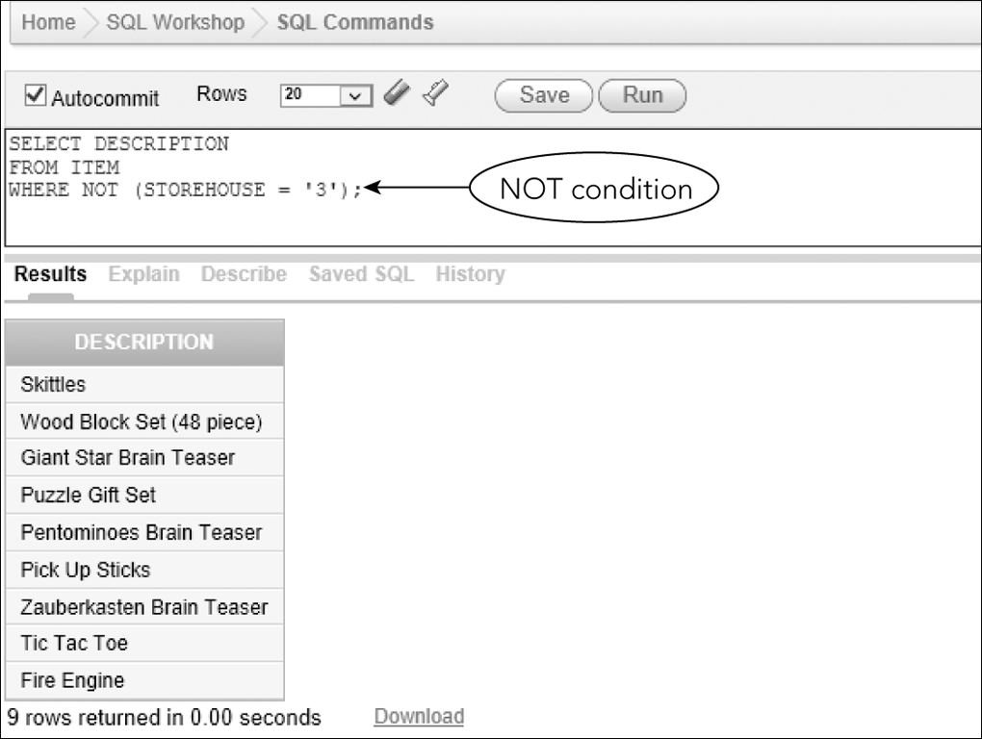
Using Compound Conditions (continued)
Figure 4-10: SELECT command with a NOT condition
©2016 Cengage Learning. All Rights Reserved. May not be copied, scanned, or duplicated, in whole or in part, except for use as permitted in a license distributed with a certain product or service or otherwise on a password-protected website for classroom use.

Slide 19
Using the BETWEEN Operator
Use instead of AND operator
Use when searching a range of values
Makes SELECT commands simpler to construct
Inclusive
  When using BETWEEN 2000 and 5000, values of 2000 or 5000 would be true
©2016 Cengage Learning. All Rights Reserved. May not be copied, scanned, or duplicated, in whole or in part, except for use as permitted in a license distributed with a certain product or service or otherwise on a password-protected website for classroom use.

Slide 20
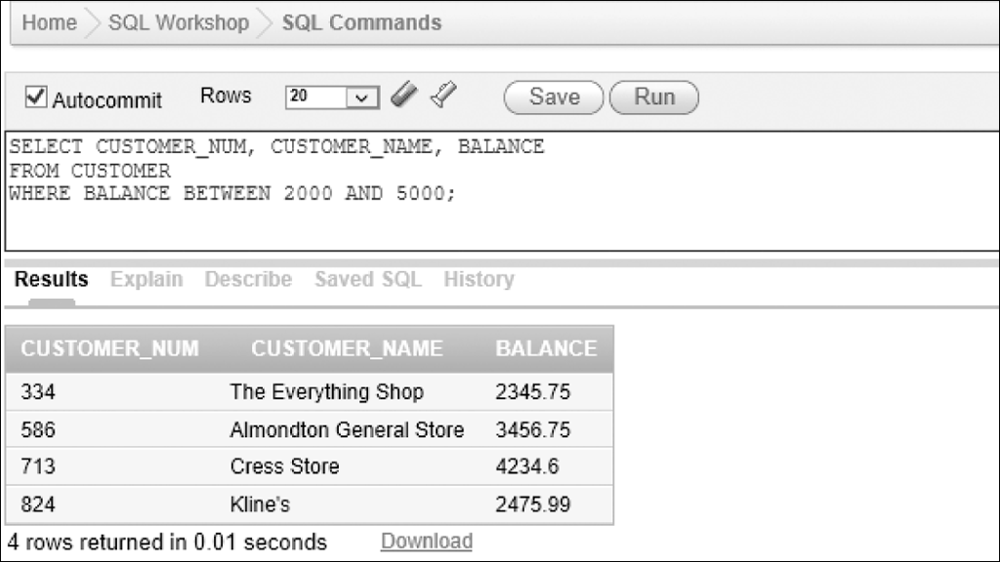
Using the BETWEEN Operator (continued)
Figure 4-12: SELECT command with the BETWEEN operator
©2016 Cengage Learning. All Rights Reserved. May not be copied, scanned, or duplicated, in whole or in part, except for use as permitted in a license distributed with a certain product or service or otherwise on a password-protected website for classroom use.

Slide 21
Using Computed Columns
Computed column
  Does not exist in the database but is computed using data in existing columns
Arithmetic operators
  + for addition
  - for subtraction
  * for multiplication
  / for division
©2016 Cengage Learning. All Rights Reserved. May not be copied, scanned, or duplicated, in whole or in part, except for use as permitted in a license distributed with a certain product or service or otherwise on a password-protected website for classroom use.

Slide 22
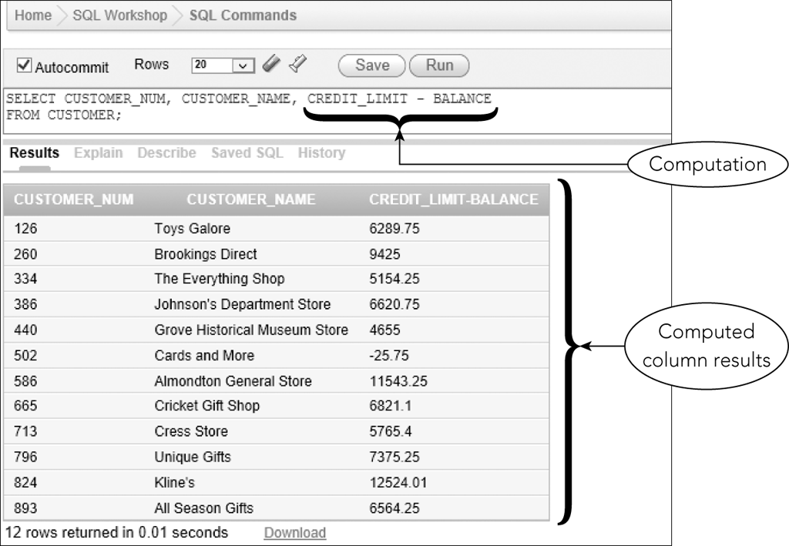
Using Computed Columns (continued)
Figure 4-14: SELECT command with a computed column
©2016 Cengage Learning. All Rights Reserved. May not be copied, scanned, or duplicated, in whole or in part, except for use as permitted in a license distributed with a certain product or service or otherwise on a password-protected website for classroom use.

Slide 23
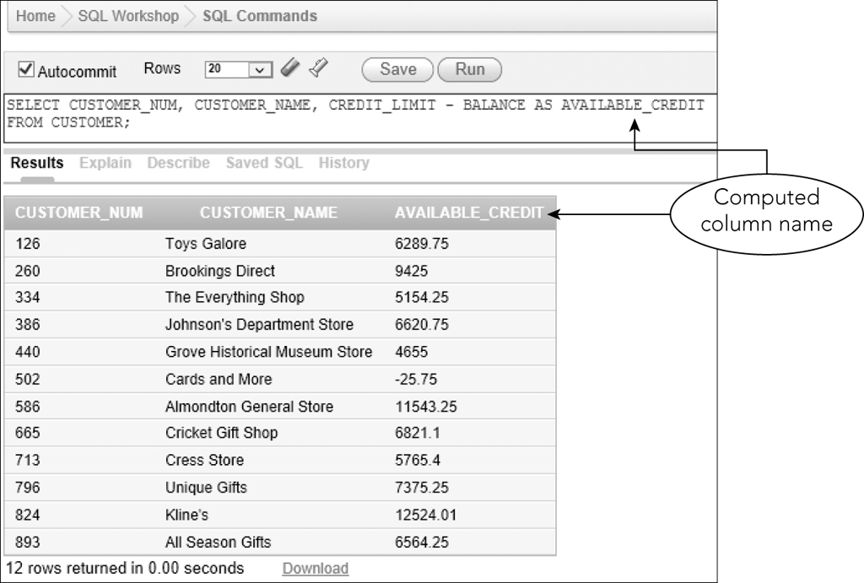
Using Computed Columns (continued)
Use AS clause to assign a name
Figure 4-15: SELECT command with a named computed column
©2016 Cengage Learning. All Rights Reserved. May not be copied, scanned, or duplicated, in whole or in part, except for use as permitted in a license distributed with a certain product or service or otherwise on a password-protected website for classroom use.

Slide 24
Using the LIKE Operator
Used for pattern matching
LIKE %Columbus% will retrieve data with those characters
  “123 Columbus” or “Columbusia”
Underscore (_) represents any single character
  “T_M” for TIM or TOM or T3M
©2016 Cengage Learning. All Rights Reserved. May not be copied, scanned, or duplicated, in whole or in part, except for use as permitted in a license distributed with a certain product or service or otherwise on a password-protected website for classroom use.

Slide 25
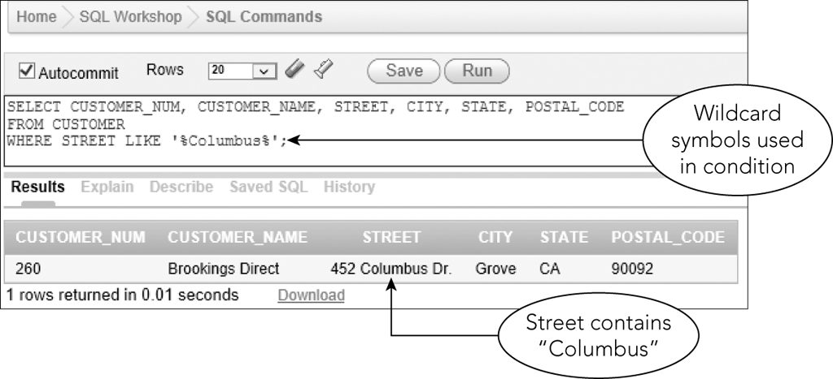
Using the LIKE Operator (continued)
Figure 4-17: SELECT command with a LIKE operator and wildcards
©2016 Cengage Learning. All Rights Reserved. May not be copied, scanned, or duplicated, in whole or in part, except for use as permitted in a license distributed with a certain product or service or otherwise on a password-protected website for classroom use.

Slide 26
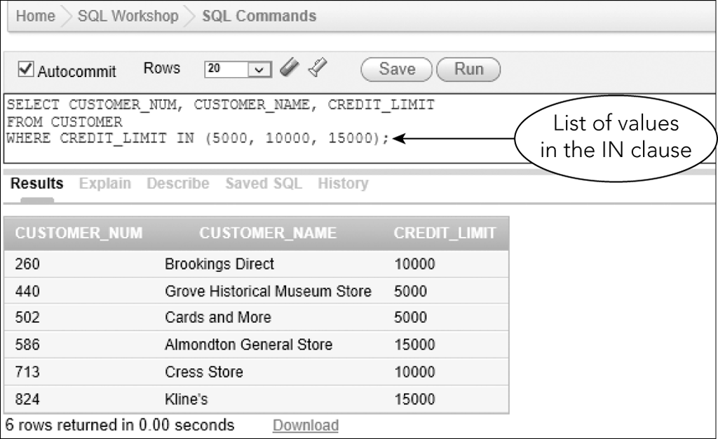
Using the IN Operator
Concise phrasing of OR conditions
Figure 4-19: SELECT command with an IN clause
©2016 Cengage Learning. All Rights Reserved. May not be copied, scanned, or duplicated, in whole or in part, except for use as permitted in a license distributed with a certain product or service or otherwise on a password-protected website for classroom use.

Slide 27
Sorting
By default, no defined order in which results are displayed
Use ORDER BY clause to list data in a specific order
©2016 Cengage Learning. All Rights Reserved. May not be copied, scanned, or duplicated, in whole or in part, except for use as permitted in a license distributed with a certain product or service or otherwise on a password-protected website for classroom use.

Slide 28
Using the ORDER BY Clause
Sort key or key
  Column on which data is to be sorted
Ascending is default sort order
©2016 Cengage Learning. All Rights Reserved. May not be copied, scanned, or duplicated, in whole or in part, except for use as permitted in a license distributed with a certain product or service or otherwise on a password-protected website for classroom use.

Slide 29
Additional Sorting Options
Possible to sort data by more than one key
Major sort key and minor sort key
List sort keys in order of importance in the ORDER BY clause
For descending order sort, use DESC
©2016 Cengage Learning. All Rights Reserved. May not be copied, scanned, or duplicated, in whole or in part, except for use as permitted in a license distributed with a certain product or service or otherwise on a password-protected website for classroom use.

Slide 30
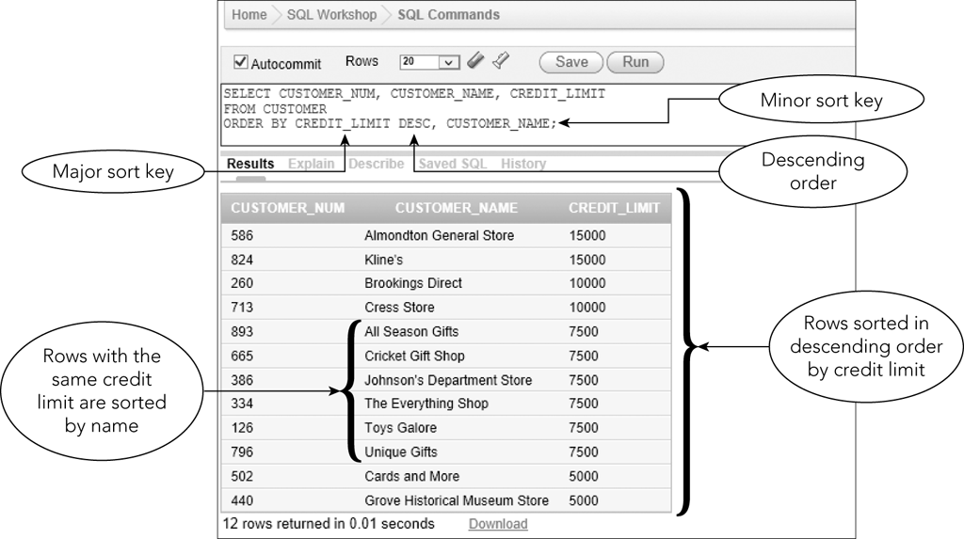
Additional Sorting Options (continued)
Figure 4-21: SELECT command to sort data using multiple sort keys
©2016 Cengage Learning. All Rights Reserved. May not be copied, scanned, or duplicated, in whole or in part, except for use as permitted in a license distributed with a certain product or service or otherwise on a password-protected website for classroom use.

Slide 31
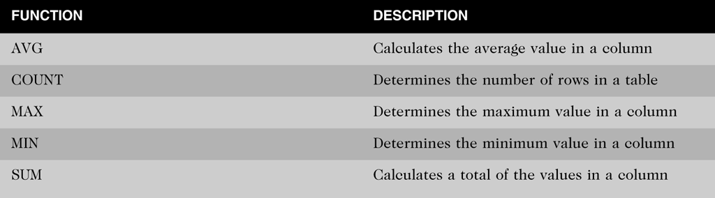
Using Functions
Aggregate functions
  Apply to groups of rows
Figure 4-22: SQL aggregate functions
©2016 Cengage Learning. All Rights Reserved. May not be copied, scanned, or duplicated, in whole or in part, except for use as permitted in a license distributed with a certain product or service or otherwise on a password-protected website for classroom use.

Slide 32
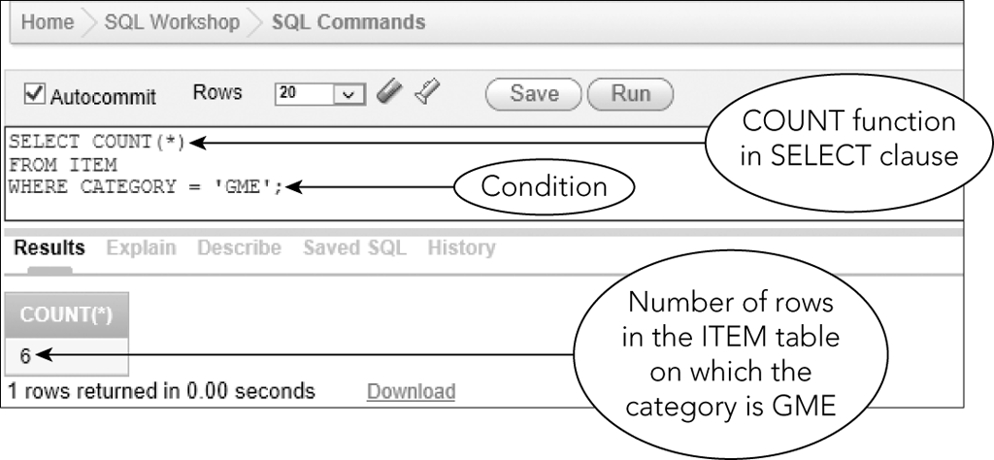
Using the COUNT Function
Counts the number of rows in a table
Can use asterisk (*) to represent any column
Figure 4-23: SELECT command to count rows
©2016 Cengage Learning. All Rights Reserved. May not be copied, scanned, or duplicated, in whole or in part, except for use as permitted in a license distributed with a certain product or service or otherwise on a password-protected website for classroom use.

Slide 33
Using the SUM Function
Used to calculate totals of columns
Column must be specified and must be numeric
Null values are ignored
©2016 Cengage Learning. All Rights Reserved. May not be copied, scanned, or duplicated, in whole or in part, except for use as permitted in a license distributed with a certain product or service or otherwise on a password-protected website for classroom use.

Slide 34
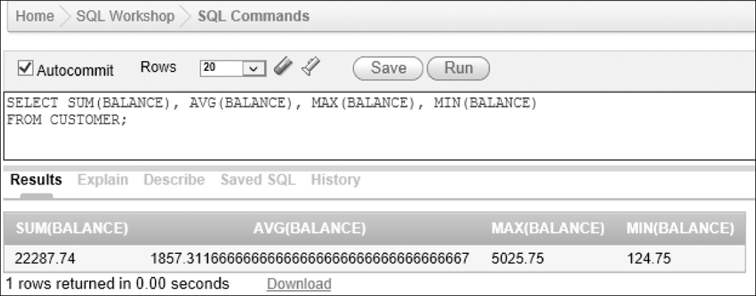
Using the AVG, MAX, and MIN Functions
Numeric columns only
Ignores nulls
Figure 4-25: SELECT command with several functions
©2016 Cengage Learning. All Rights Reserved. May not be copied, scanned, or duplicated, in whole or in part, except for use as permitted in a license distributed with a certain product or service or otherwise on a password-protected website for classroom use.

Slide 35
Using the DISTINCT Operator
Eliminates duplicate values
Used with COUNT function
©2016 Cengage Learning. All Rights Reserved. May not be copied, scanned, or duplicated, in whole or in part, except for use as permitted in a license distributed with a certain product or service or otherwise on a password-protected website for classroom use.

Slide 36
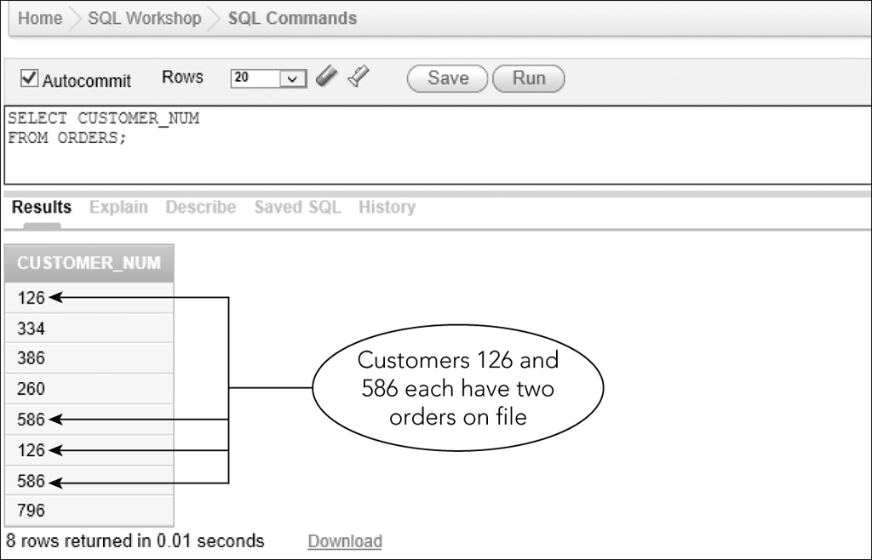
Using the DISTINCT Operator (continued)
Figure 4-26: Number of customers with open orders
©2016 Cengage Learning. All Rights Reserved. May not be copied, scanned, or duplicated, in whole or in part, except for use as permitted in a license distributed with a certain product or service or otherwise on a password-protected website for classroom use.

Slide 37
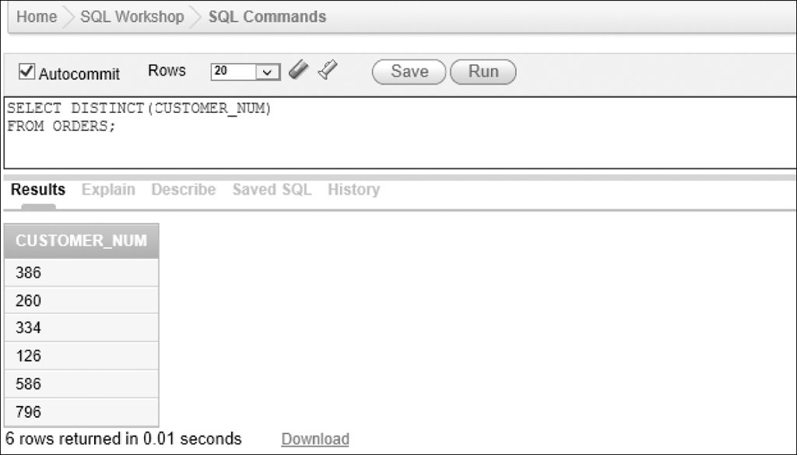
Using the DISTINCT Operator (continued)
Figure 4-27: Number of customers with open orders and with duplicates removed
©2016 Cengage Learning. All Rights Reserved. May not be copied, scanned, or duplicated, in whole or in part, except for use as permitted in a license distributed with a certain product or service or otherwise on a password-protected website for classroom use.

Slide 38
Nesting Queries
Query results require two or more steps
Subquery: an inner query placed inside another query
Outer query uses subquery results
©2016 Cengage Learning. All Rights Reserved. May not be copied, scanned, or duplicated, in whole or in part, except for use as permitted in a license distributed with a certain product or service or otherwise on a password-protected website for classroom use.

Slide 39
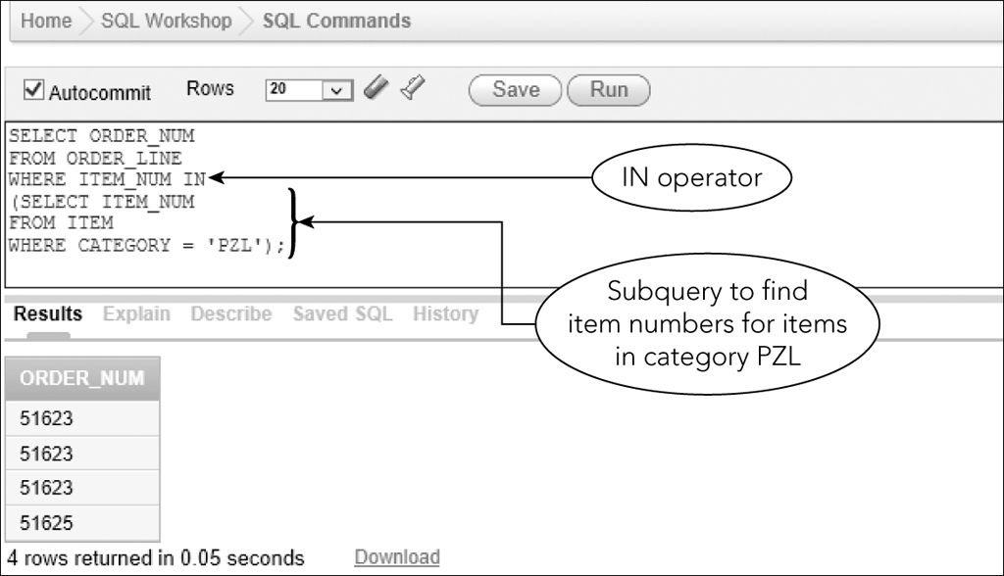
Nesting Queries (continued)
Figure 4-32: Using the IN operator and a subquery
©2016 Cengage Learning. All Rights Reserved. May not be copied, scanned, or duplicated, in whole or in part, except for use as permitted in a license distributed with a certain product or service or otherwise on a password-protected website for classroom use.

Slide 40
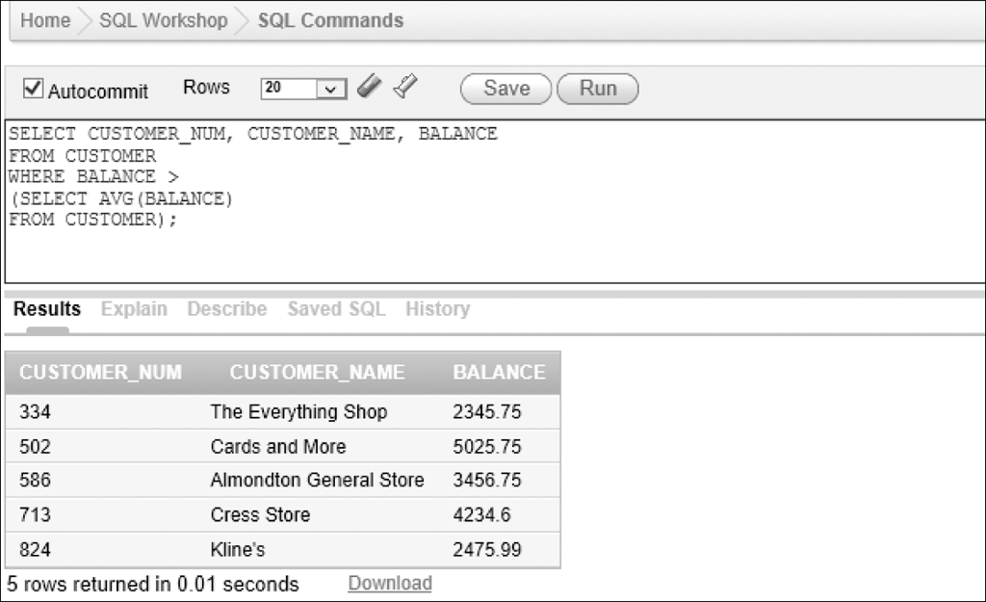
Nesting Queries (continued)
Figure 4-33: Query using an operator and a subquery
©2016 Cengage Learning. All Rights Reserved. May not be copied, scanned, or duplicated, in whole or in part, except for use as permitted in a license distributed with a certain product or service or otherwise on a password-protected website for classroom use.

Slide 41
Grouping
Grouping: creates groups of rows that share common characteristics
Calculations in the SELECT command are performed for the entire group
©2016 Cengage Learning. All Rights Reserved. May not be copied, scanned, or duplicated, in whole or in part, except for use as permitted in a license distributed with a certain product or service or otherwise on a password-protected website for classroom use.

Slide 42
Using the GROUP BY Clause
Group data on a particular column
Calculate statistics
©2016 Cengage Learning. All Rights Reserved. May not be copied, scanned, or duplicated, in whole or in part, except for use as permitted in a license distributed with a certain product or service or otherwise on a password-protected website for classroom use.

Slide 43
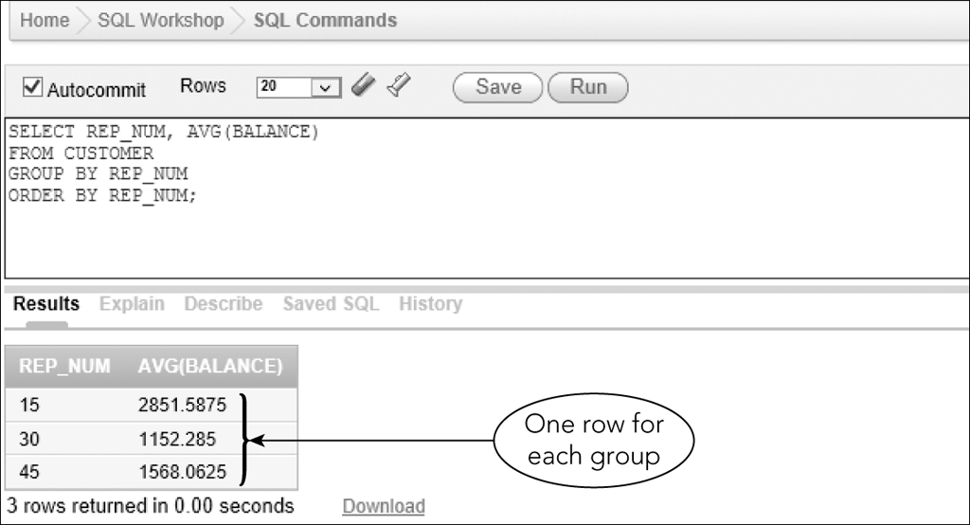
Using the GROUP BY Clause (continued)
Figure 4-34: Grouping records on a column
©2016 Cengage Learning. All Rights Reserved. May not be copied, scanned, or duplicated, in whole or in part, except for use as permitted in a license distributed with a certain product or service or otherwise on a password-protected website for classroom use.

Slide 44
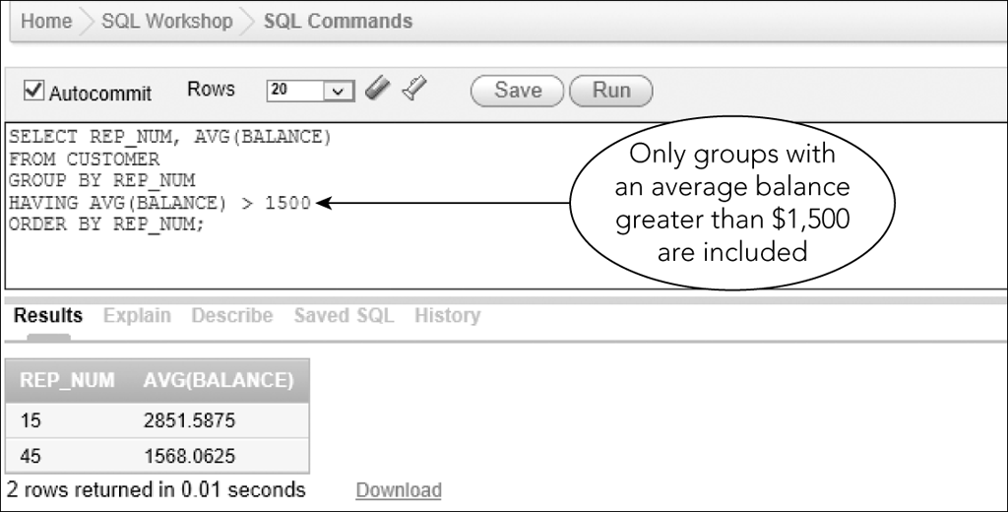
Using a HAVING Clause
Used to restrict groups that will be included
Figure 4-35: Restricting the groups to include in the results
©2016 Cengage Learning. All Rights Reserved. May not be copied, scanned, or duplicated, in whole or in part, except for use as permitted in a license distributed with a certain product or service or otherwise on a password-protected website for classroom use.

Slide 45
Having vs. Where
WHERE: limit rows
HAVING: limit groups
Can use together if condition involves both rows and groups
©2016 Cengage Learning. All Rights Reserved. May not be copied, scanned, or duplicated, in whole or in part, except for use as permitted in a license distributed with a certain product or service or otherwise on a password-protected website for classroom use.

Slide 46
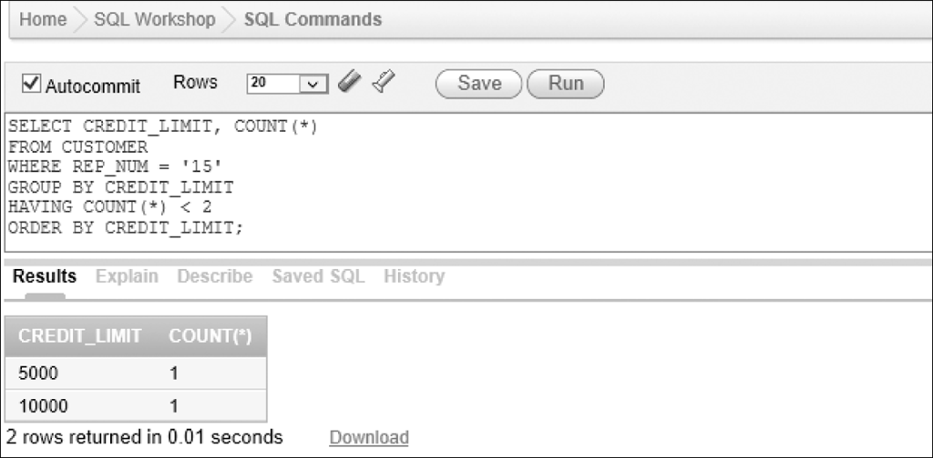
Having vs. Where (continued)
Figure 4-39: Restricting the rows and the groups
©2016 Cengage Learning. All Rights Reserved. May not be copied, scanned, or duplicated, in whole or in part, except for use as permitted in a license distributed with a certain product or service or otherwise on a password-protected website for classroom use.

Slide 47
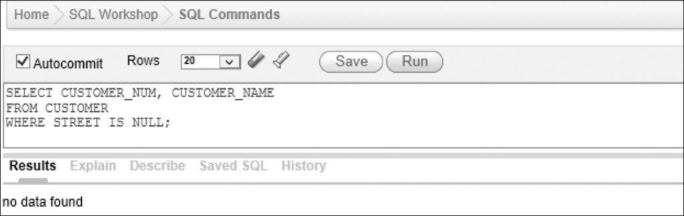
Nulls
Condition that involves a column that can be null
  IS NULL
  IS NOT NULL
Figure 4-40: Selecting rows containing null values in the STREET column
©2016 Cengage Learning. All Rights Reserved. May not be copied, scanned, or duplicated, in whole or in part, except for use as permitted in a license distributed with a certain product or service or otherwise on a password-protected website for classroom use.

Slide 48
Summary
Create queries that retrieve data from a single table using SELECT commands
Comparison operators
  =, >,=>,<,=<, or <>, or !=
Compound conditions
  AND,OR, and NOT
Use the BETWEEN operator
Use the LIKE operator
©2016 Cengage Learning. All Rights Reserved. May not be copied, scanned, or duplicated, in whole or in part, except for use as permitted in a license distributed with a certain product or service or otherwise on a password-protected website for classroom use.

Slide 49
Summary (continued)
IN operator
ORDER BY clause
Aggregate functions
  COUNT, SUM, AVG, MAX, and MIN
  DISTINCT operator
Subqueries
GROUP BY
  HAVING
NULL
©2016 Cengage Learning. All Rights Reserved. May not be copied, scanned, or duplicated, in whole or in part, except for use as permitted in a license distributed with a certain product or service or otherwise on a password-protected website for classroom use.

